Slide 1
Nodejs MySQL Demo

Slide 2
Installing MySQL
Download a free MySQL database from:
https://www.mysql.com/downloads/.
Install MySQL Driver:
npm install mysql --save

Slide 3

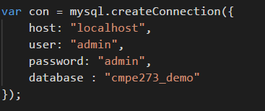
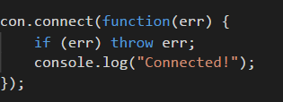
Create a Connection

Slide 4
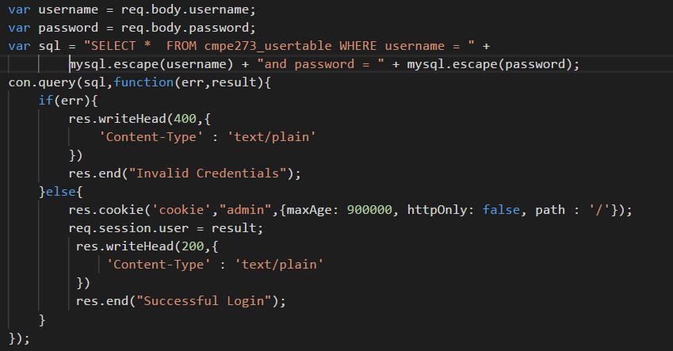
SELECT Query

Slide 5
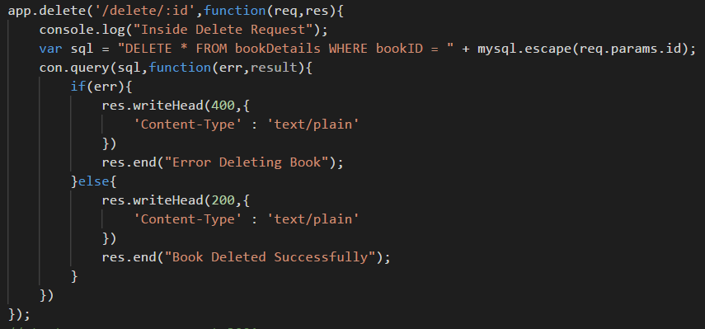
DELETE Query

Slide 6
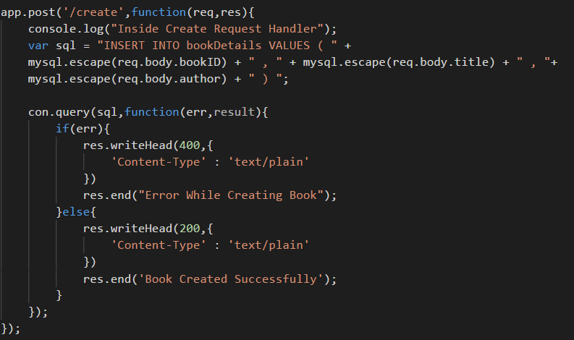
INSERT Query

Slide 7
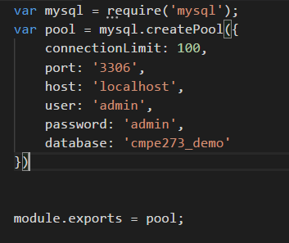
Connection Pooling

Slide 8
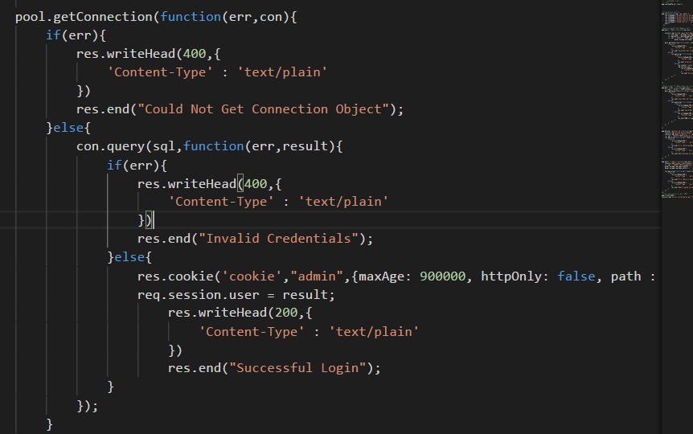
Connection Pooling - Continued

Slide 9
DEMO

